Slide 1
MODULE A UNIT A2

Slide 2
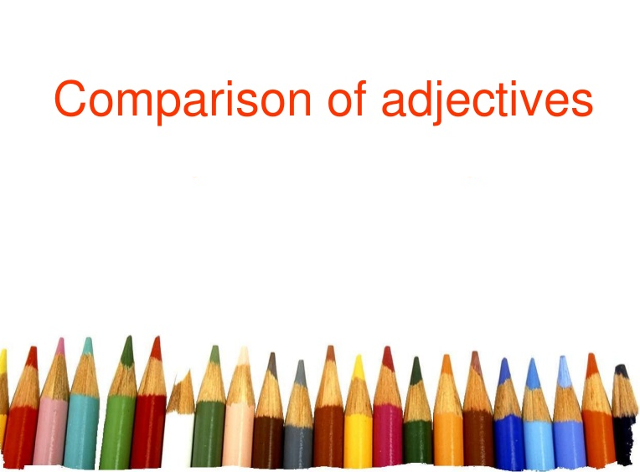

Slide 3
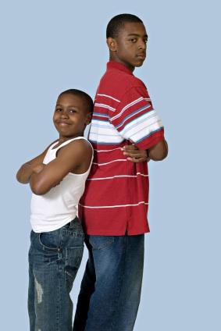
What are Comparative Adjectives?
Comparative adjectives compare two things, people, or places unlike positive adjectives which stand alone and do not make comparisons between nouns. Frequently, the word than accompanies the comparative but not always.
Paul is taller than John.
The taller boy is Paul.

Slide 4
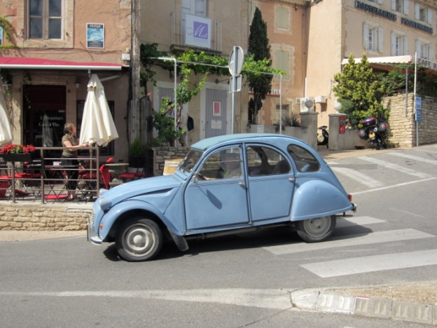
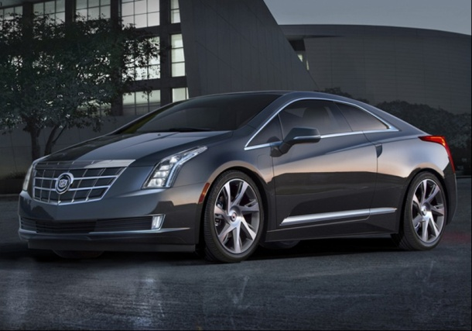
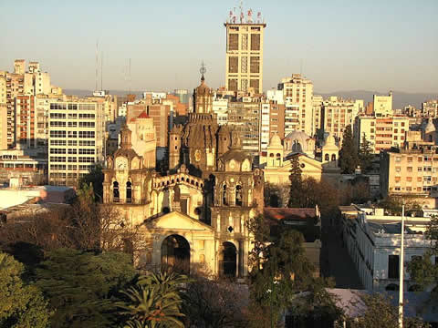
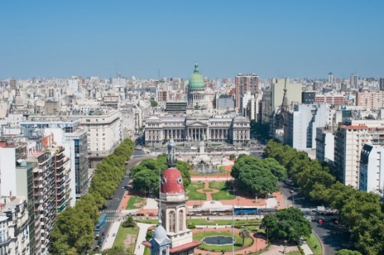
Forming Comparative Adjectives
In some cases the comparative is formed by adding the suffix –er (or –r ) to a one syllable adjective. Sometimes two syllable words become comparative with an – er suffix as well:
This car is older than that one.
Córdoba is nicer than Buenos Aires.

Slide 5
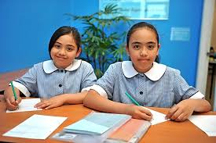
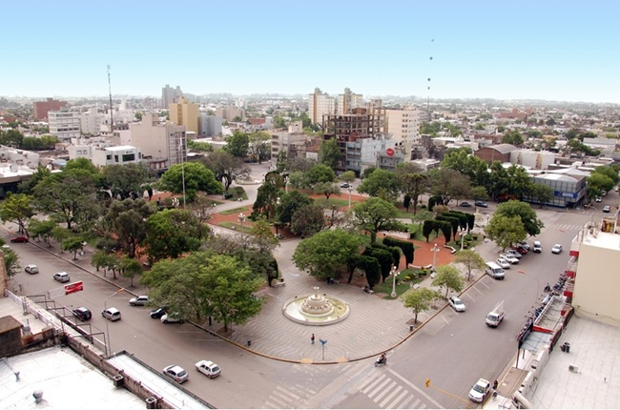
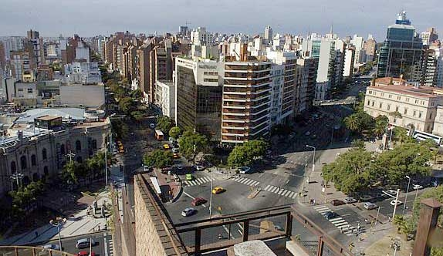
At other times the words more or less precede a two or three syllable adjective to show degrees of comparison:
Jane is more intelligent than her sister.
Villa María is less crowded than Córdoba.

Slide 6
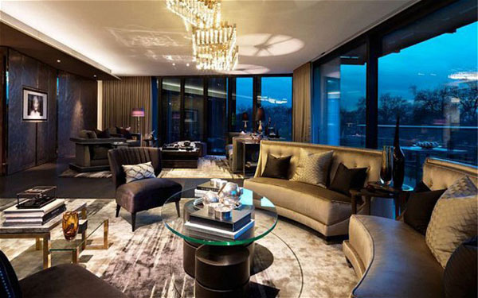
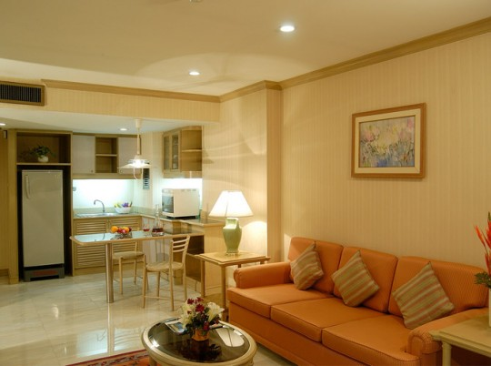
When we want to show a small difference when making comparisons we can use “a little”. To show a big difference we can use “much”:
Your house is a little bigger than my house.
My new apartment is much more expensive than my old apartment.

Slide 7

Here is a list of some common adjectives and their comparative forms:
anxious – more anxious
beautiful – more beautiful
broad – broader
cold – colder
friendly – friendlier
happy – happier
nervous – more nervous
perfect – more perfect
smart – smarter

Slide 8

Irregular Forms
Some adjectives have irregular forms in the comparative degree, meaning they don’t have a suffix –er nor do they need the words more or less. The comparative forms of these adjectives are totally different words.
good – better
little – less
bad – worse
far – farther
much – more

Slide 9

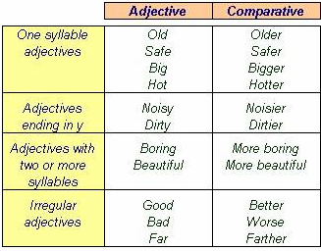

Slide 10

Comparison of Equality
To say that two nouns are equal, the following formula is used:
As + adjective + as (tan + adjectivo + como)
She is as tall as her brother.
The Empire State is as beautiful as the Obelisk.
It’s as cold as yesterday.

Slide 11
What would be the equivalent in Spanish?
As good as gold: Children are as good as gold.
As poor as a church mouse: Her aunt is as poor as a church mouse.
As brave as a lion (also as fierce as a tiger): He fought for his ideals very much, he’s as brave as a lion.
As blind as a bat: I’m as blind as a bat without my glasses.
As pale as a ghost (also as white as a sheet): Ann came into the room as pale as a ghost.
As wise as an owl: You need to be as wise as an owl to solve this problem.
As white as snow: His hair and beard were as white as snow.
As light as a feather: I could lift you up, you’re as light as a feather.

Slide 12
We can add “just” to emphasize that two things are the same:
My room is just as big as yours.
When we want to show that two people, places, or things are very similar in some way but not the same, we can add “almost”:
Her new book is almost as interesting as the previous book.

Slide 13
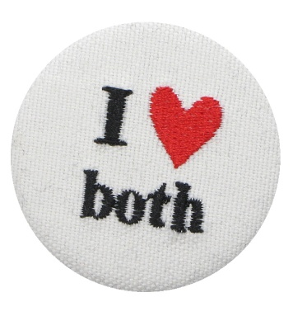
We use “like” to compare people, places, or things to show that one noun is similar to another noun.
What is Tokyo like?
Tokyo is a lot like New York.
We can also use “both” to show that two people or things are similar.
Both cities are amazing.

Slide 14


When the two nouns we compare are the same, we use “the same” or “the same as”:
I have the same teacher in my English class as my brother.
We can use “different from” to talk about things that are not the same:
Sue is different from her sister. She is more serious.

Slide 15
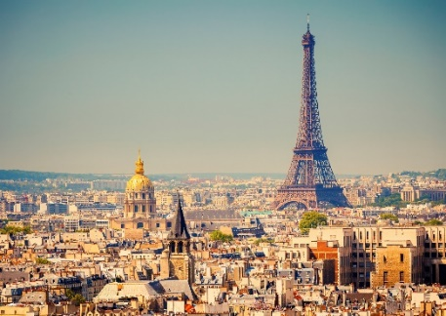
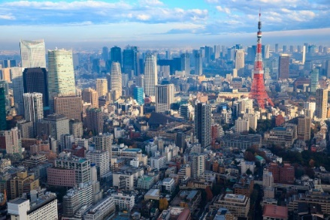
Inequality: adjectives
We can show that two things are not equal using not + as + adjective + as. When we use this structure, the first thing mentioned is 'less' than the second thing. (The order of the things you are comparing is opposite to that used in comparisons with comparative adjectives).
This house isn't as big as the old one. (The old one is bigger than this one.)
Paris isn't as big as Tokyo (Tokyo is bigger than Paris.)

Slide 16
Examples:
1. The house at the corner of the street is _________ (big +) all the houses on the street.
2. German lessons are ____________ (interesting -) English ones!
3. That park is __________(verdant +) the one that is near my brother's school.
4. Tom is __________ (lazy +) his sister, who works a lot.
5. Peter is ______________ (combative =) his father : they never give up.
6. The sofa we've just bought is _________ (comfortable -) the one we had before.
7. Julie tried to do her best but unfortunately for her, things are ___________ (bad +) before.
8. She is ____________ (hardworking -) her classmates: she's lazy so she doesn't learn and cheats.

Slide 17
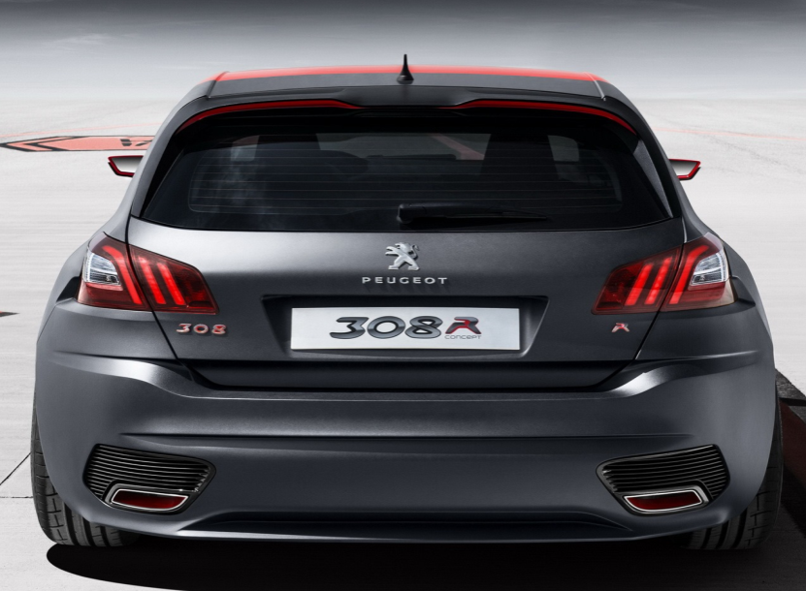
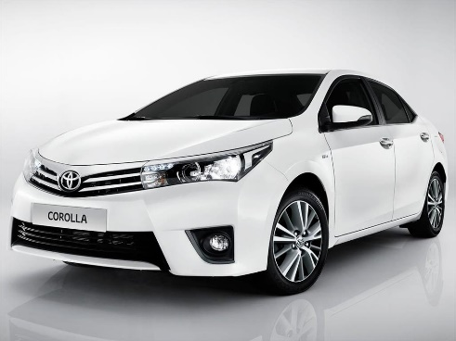
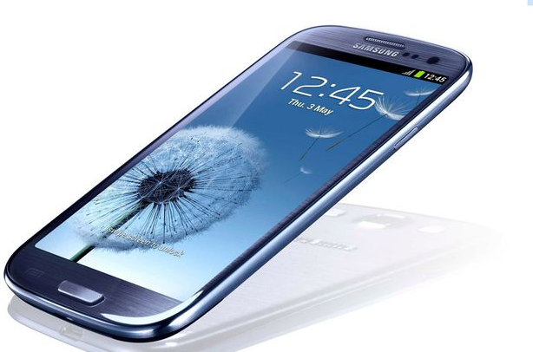

Peugeot 308 - Toyota Corolla 2016
Samsung Galaxy S3 – Samsung Galaxy S7
expensive / cheap
comfortable / uncomfortable
new / old
expensive / cheap
New / old
Big / small

Slide 18
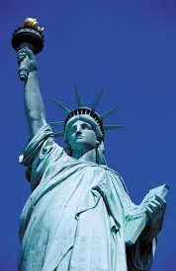
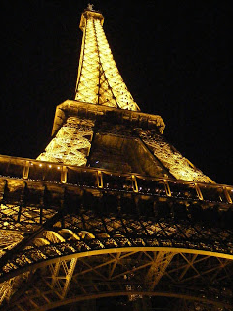
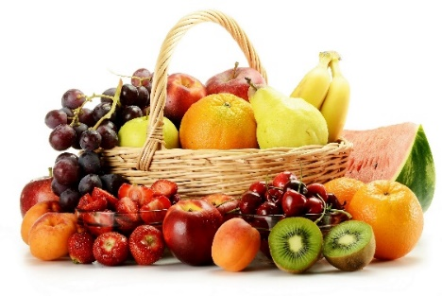
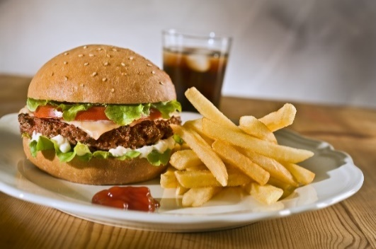
The Statue of Liberty – The Eiffel Tower
Fruits – Junk food
93 mts 324 mts
October 28, 1886 March 31, 1889
healthy / unhealthy
natural / artificial
Tasty / tasteless

Slide 19

Superlative Adjectives

Slide 20
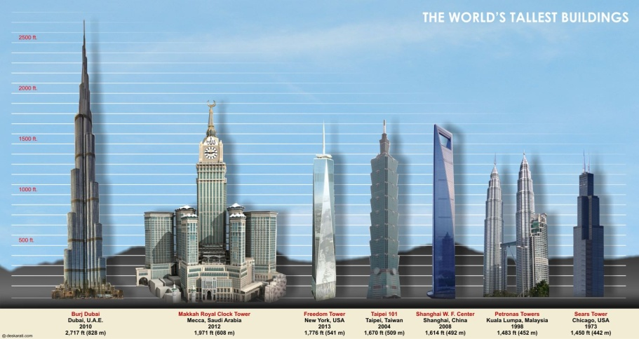
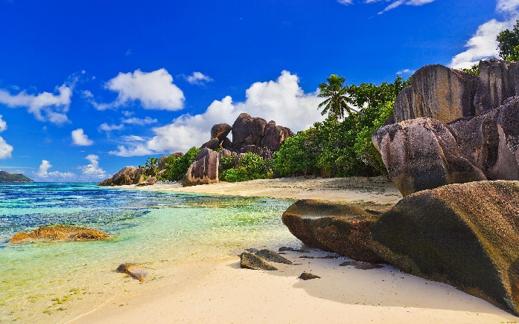
A superlative adjective is used to compare three or more objects, people, or places. Using the superlative form takes a comparison to the highest or the lowest degree possible.
The rules for creating superlative adjectives are similar to those used when making comparative adjectives, except that we don’t use the word “than”, we add “the” before the superlative form:
The Burj Khalifa in Dubai is the tallest building in the world.
This beach is the most beautiful place in the world.

Slide 21
For a one-syllable word simply add the suffix –est to the word. Often times it is necessary to double the final consonant:
Long-longest
Big – Biggest
If the one syllable word ends with an -e you only need to add –st:
Fine-finest

Slide 22
If a two-syllable word ends with a -y then change the -y to -i and add –est:
Pretty – prettiest
Words that contain two or three syllables are preceded by the words most or least:
most handsome
least perfect.

Slide 23

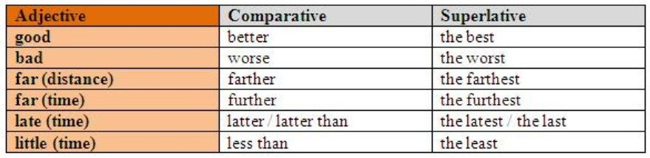
Irregular Forms
There are some adjectives that have irregular forms meaning that the superlative can’t be formed by adding the suffix -est or by using the words most or least. Here are some examples:

Slide 24
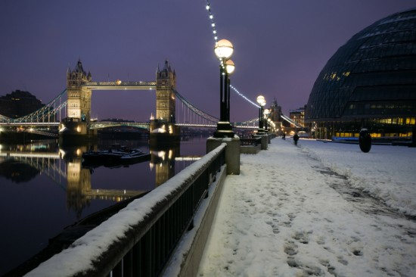
When we compare one thing with itself, we do not use "the":
England is coldest in winter. (not the coldest)
My boss is most generous when we get a big order. (not the most generous)

Slide 25
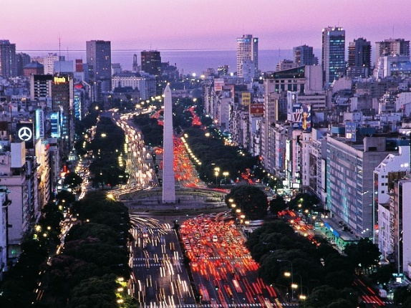
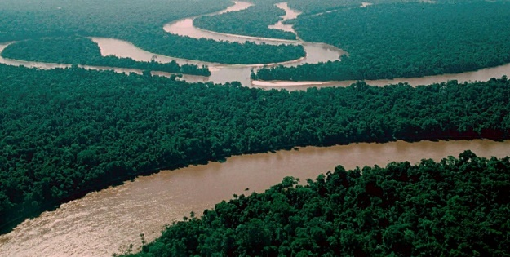
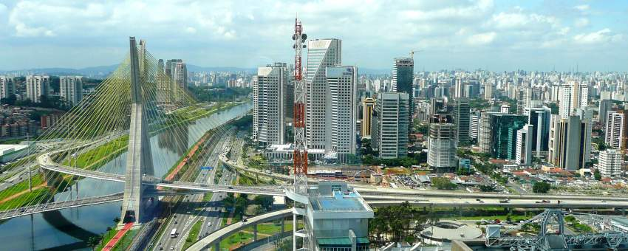
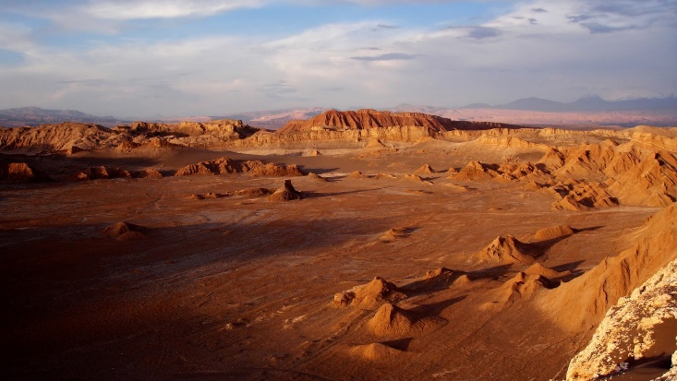
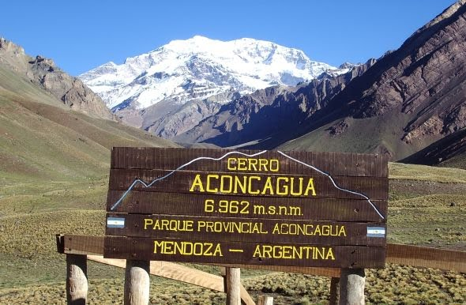
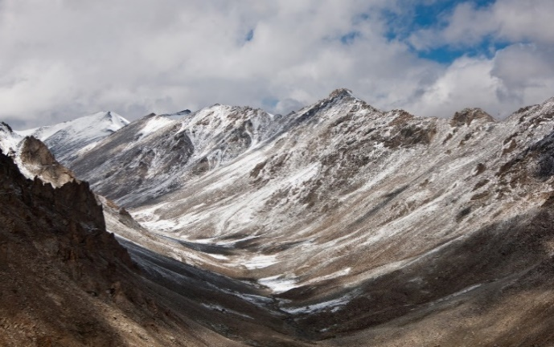
The Amazon River (long and wide) in America
Sao Paulo City (large) in America
Buenos Aires City (populous) in America
SAY SENTENCES
Cerro Aconcagua (high point) in America
Andes (famous - long) Mountain Range in America
Atacama Desert in Chile (dry) in America

Slide 26


Slide 27
Comparative and superlative forms of adjectives.
http://www.ompersonal.com.ar/INTERMEDIATE/unit14/page2.htm
http://www.ompersonal.com.ar/INTERMEDIATE/unit14/page3.htm
http://www.ompersonal.com.ar/omgrammar/comparativosysuperlativos.htm
http://www.ompersonal.com.ar/omgrammar/comparativosysuperlativos2.htm
http://www.englishexercises.org/makeagame/viewgame.asp?id=6009
https://www.ego4u.com/en/cram-up/grammar/adjectives-adverbs/adjectives/exercises
http://www.myenglishpages.com/site_php_files/grammar-exercise-grammar-comparatives-superlatives.php
http://www.ompersonal.com.ar/INTERMEDIATE/unit4/page2.htm (dialogues)

